Slide 1


Practice
Collect Instagram Data
Digital Business Ecosystem Research Center

Slide 2
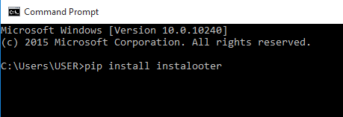
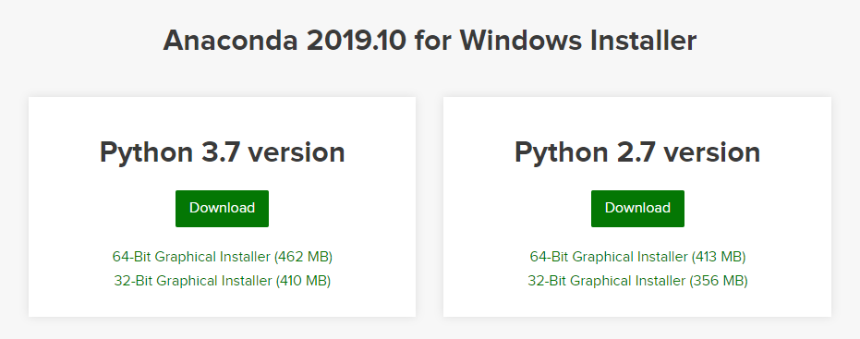

Installation
Download and Install Python 3 or Anaconda
Open CMD
Write “pip install instalooter”
Enter

Slide 3
Collecting Data (User)
Open CMD
Write “ instalooter user username directory”
Enter
Example: instalooter user telkomindonesia E:\

Slide 4
Collecting Data (Hashtag)
Open CMD
Write “instalooter hashtag hashtagname directory”
Enter
Example: instalooter hashtag selaluadajawaban E:\

Slide 5
Collecting Data (Include Caption and Comment)
Open CMD
Write “instalooter hashtag hashtagname directory –d –m -e”
Enter
Example: instalooter hashtag selaluadajawaban E:\ -d –m –e

Slide 6
Collecting Data (Date, Number of Like, Number of Comments)
Open CMD
Write “ instalooter user username –T {datetime}.{likescount}.{commentscount}”
Enter
Example: instalooter user telkomuniversity -T{datetime}.{likescount}.{commentscount}

Slide 7

THANK YOU

